Slide 1


Slide 2
Made by Sravanthi Kanchi
Saloni Kalsekar
Neha Jinwala

Slide 3
INSPIRATION
Diabetes patients glucose levels keep changing frequently and most of the time users are unable to get their glucose level at that instant. Also, the main challenge of diabetes patients is to maintain their blood sugar levels.

Slide 4
WHAT IT DOES
This web app predicts the glucose level in real time based on parameters like pregnancies, bmi, age, blood pressure, insulin level and also gives the level of diabetes of the patient. It suggests the diet that diabetic patients should have based on their diabetes level

Slide 5
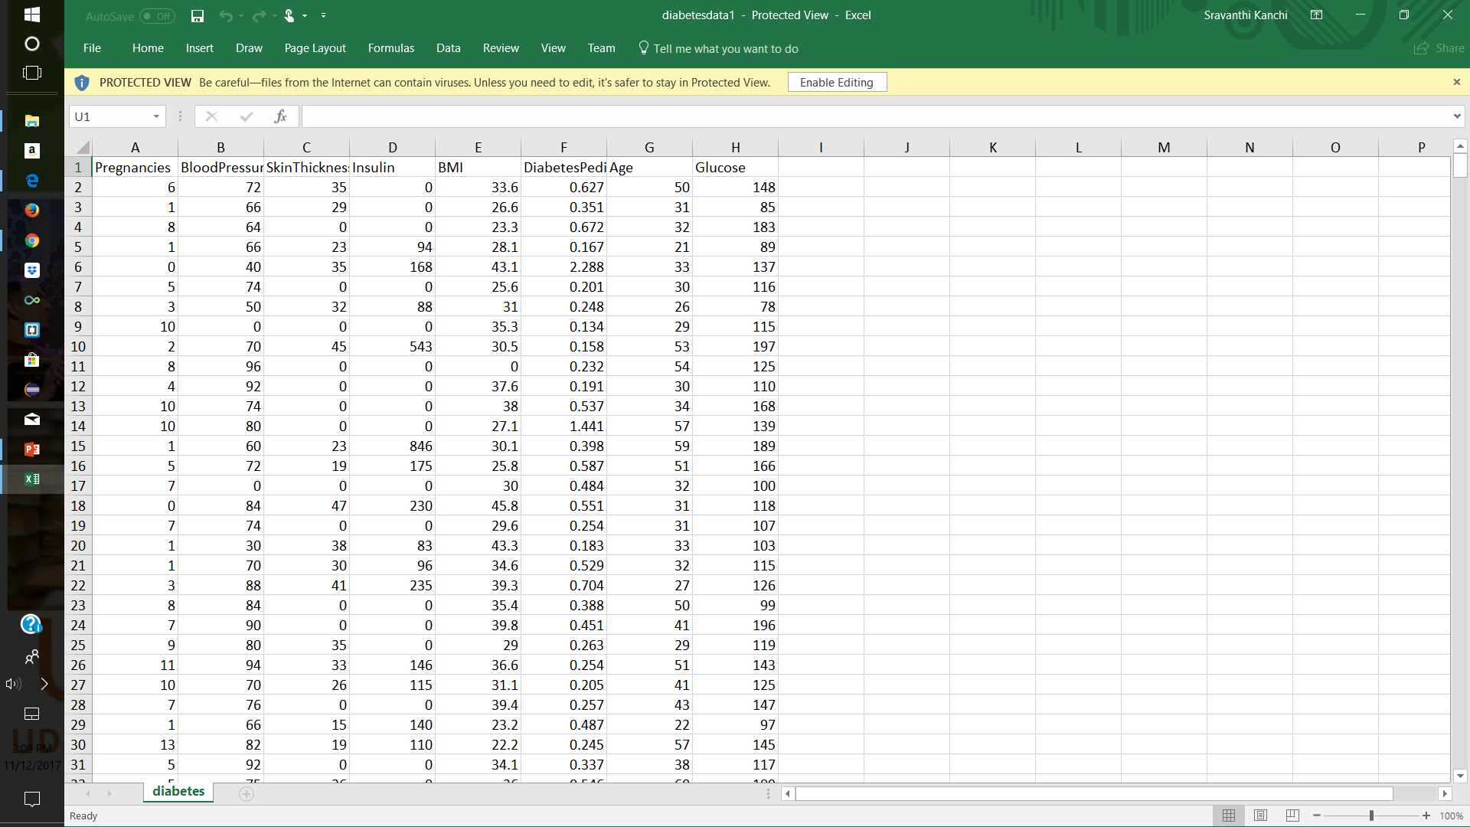

Slide 6
This can be used by women and it will help a lot of women especially in their pregnancy. It will help them know instantly about their glucose level. To predict the glucose level we have used machine learning algorithm in – multivariate linear regression.

Slide 7
What’s next for Diabetes Prediction for Women:
We can use this to know different levels of diabetes and help women search for doctors near by for treatment.

Slide 8
THANK YOU

